Slide 1
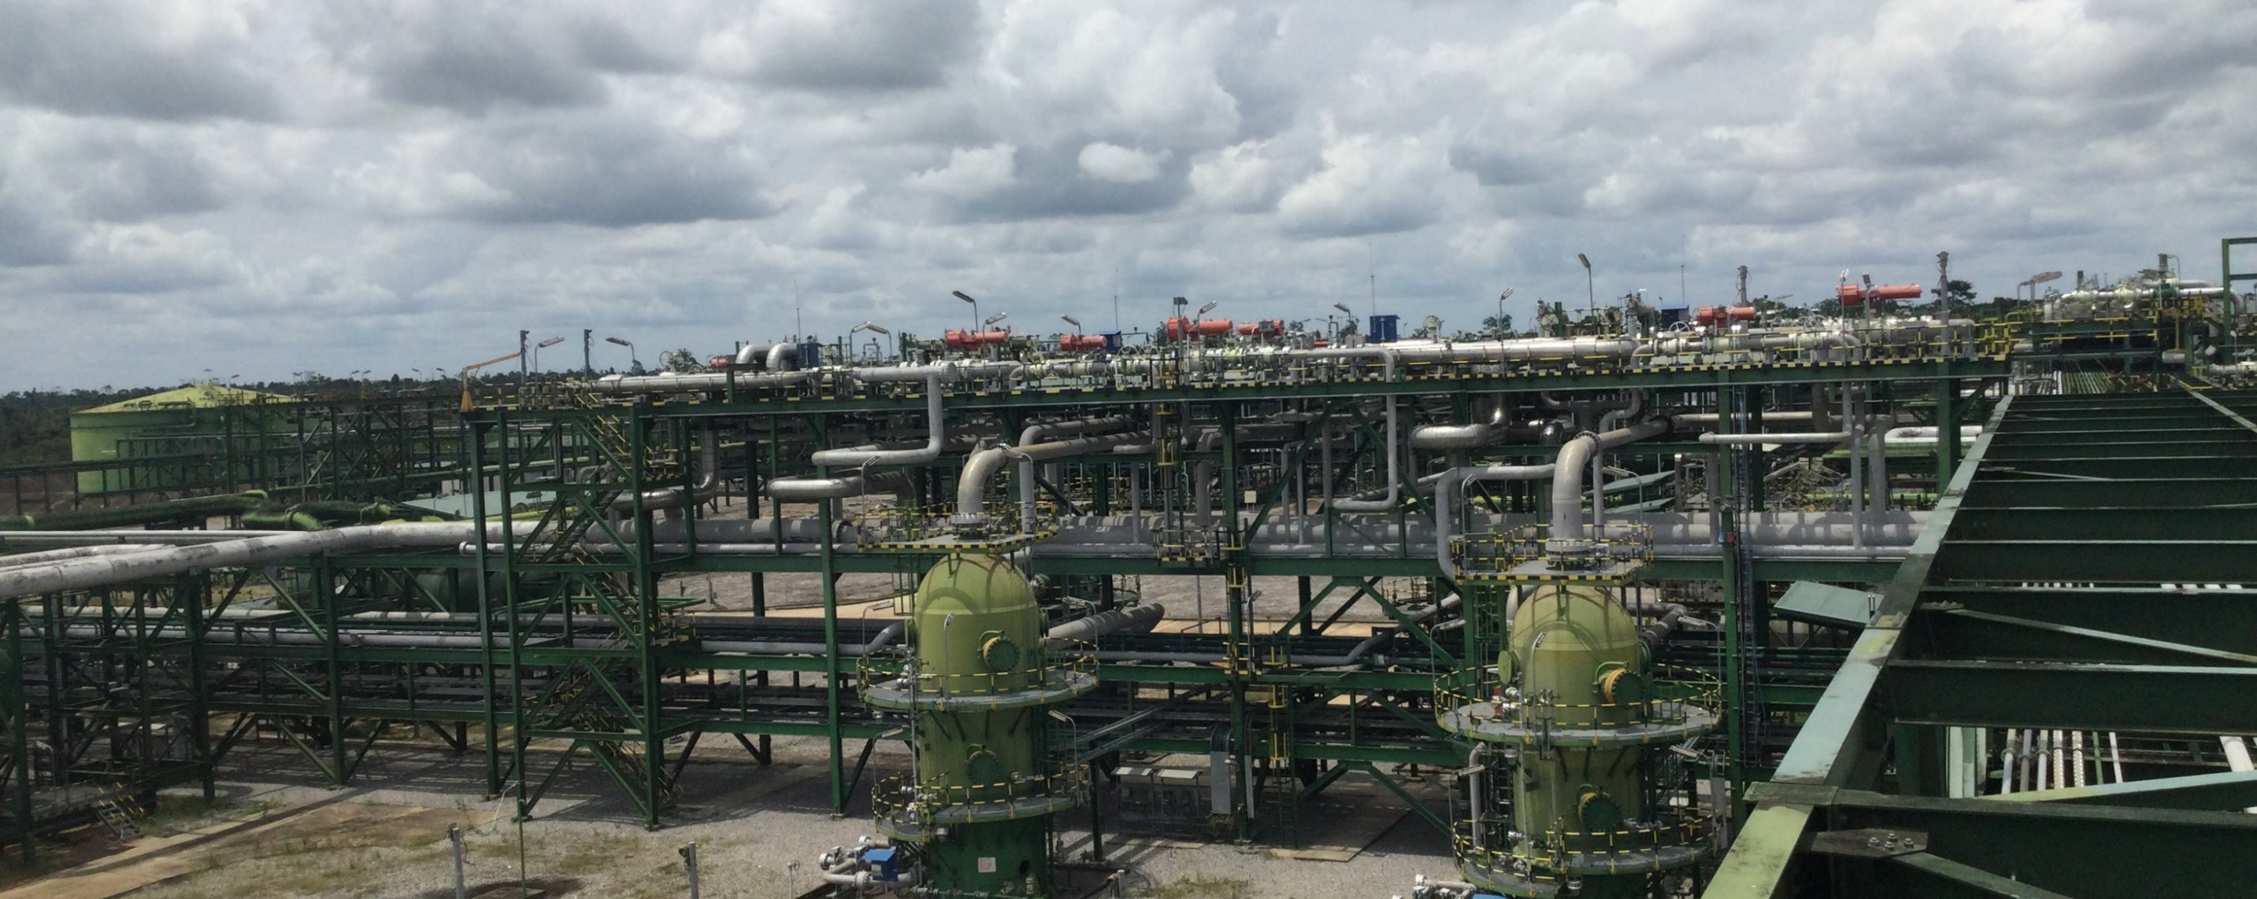
All Fire Water Pumps Running at the Same Time on 19th Sept; 2022 A Simple 5-Why Investigation
24th September 2022

Slide 2
Investigation Team
Saheed Ibrahim – Investigation Lead
Miebi Debekeme – Facilitator
Abass Kabir – Member (Mechanical)
Ojiabo Chiemezie – Member (Mechanical)
David Kpoudosu– Member (Electrical)
Amachree Tonye – Member (Fire)

Slide 3
Problem Statement
Expected
Jockey pumps to intermittently maintain pressure in the ring main at 10bar. While the duty main pumps comes up when line pressure drops below 7bar.
Actual
All fire water pumps started running continuously at the time.
Impact
Potential rupture of the GRE discharge line.

Slide 4
Key Timeline – 19th September 2022
At about 0815hrs: Fire team observed minor leaks from a fire hydrant, GBRG1-FH-0005.
At about 0820hrs: Mechanical team on FLM checks observed an escalation of water leaks from Fire hydrant, GBRG1-FH-0005 and call the attention of the Fire team.
At about 0825hrs: Ring main isolation valve was isolated to stop the hydrant leaks.
At about 0830hrs: Fire team informed Central Control Room.
At about 0852hrs: Line pressure around fire hydrant, GBRG1-FH-0005 dropped below 7bar.
At about 0852hrs: The first fire water pump on duty started automatically.
At about 0853hrs: Line pressure around fire hydrant, GBRG1-FH-0005 dropped to 0bar.
At about 1330hrs: CRO observed all fire water pumps running at the same time.
At about 1400hrs: Field operator attempt to switch off the pumps failed.
At about 1500hrs: Mechanical team blind flange the hydrant.
At about 1524hrs: The Ring main valve was de-isolated and line pressure was restored back to 10bar.
At about 1540hrs: Main fire water pumps were stopped and put on standby.

Slide 5
Key Findings
Abusive use of the Fire water hydrant, GBRG1-FH-0005 in the CPF.
The hydrant open/close valve was leaking and discharging water at high pressure.
The pressure control transmitter, GBRG163PZT015 initiated a continuous start command to all firewater pumps on sensing line pressure below 7bar on a section of the hydrant line in CPF.
1oo4 voting system is the designed configuration for the Fire water pump pressure transmitters.
The line pressure dropped to 0 bar as confirmed from pressure control transmitter, GBRG163PZT015.
Inadequate understanding of the impact of the isolation of the fire water ring main.
Isolation of the Ring main was done before informing the CCR.
All Fire Water Pumps continued to run on Auto mode because the pressure control transmitter, GBRG163PZT015 was still at 0 bar.
The ‘Start Command’ signal was still active when the Field operator attempted to stop the running pumps.
The leaking hydrant was blind flanged due to unavailability of valve spares.

Slide 6
Recommendations
Ensure PTW process captures 3rd-party contractors' usage of hydrant system.
Validate fire water pump operation philosophy and carry out knowledge sharing for O&M team.
Reinforce valve isolation procedure in CPF.
Ensure availability of spares for hydrant system for intervention.
The use of fire water for any other activities other than fire fighting should be prohibited.
Encourage the use of open-air radio communication as against current practice of personal tetra radio telephone communication to enable all work party/teams to know ongoing activities and impact on other activities they intend doing. This will also enable site leadership and other stakeholder intervene in case of abnormal practices.

